Slide 1


BioScope Explorer: Interactive Microscope Simulation for Education
Welcome to the future of science education. BioScope Explorer offers a revolutionary approach to learning microscopy, making it accessible and engaging for everyone.
By: Vedansh Tonk
Date: 23-06-2025

Slide 2
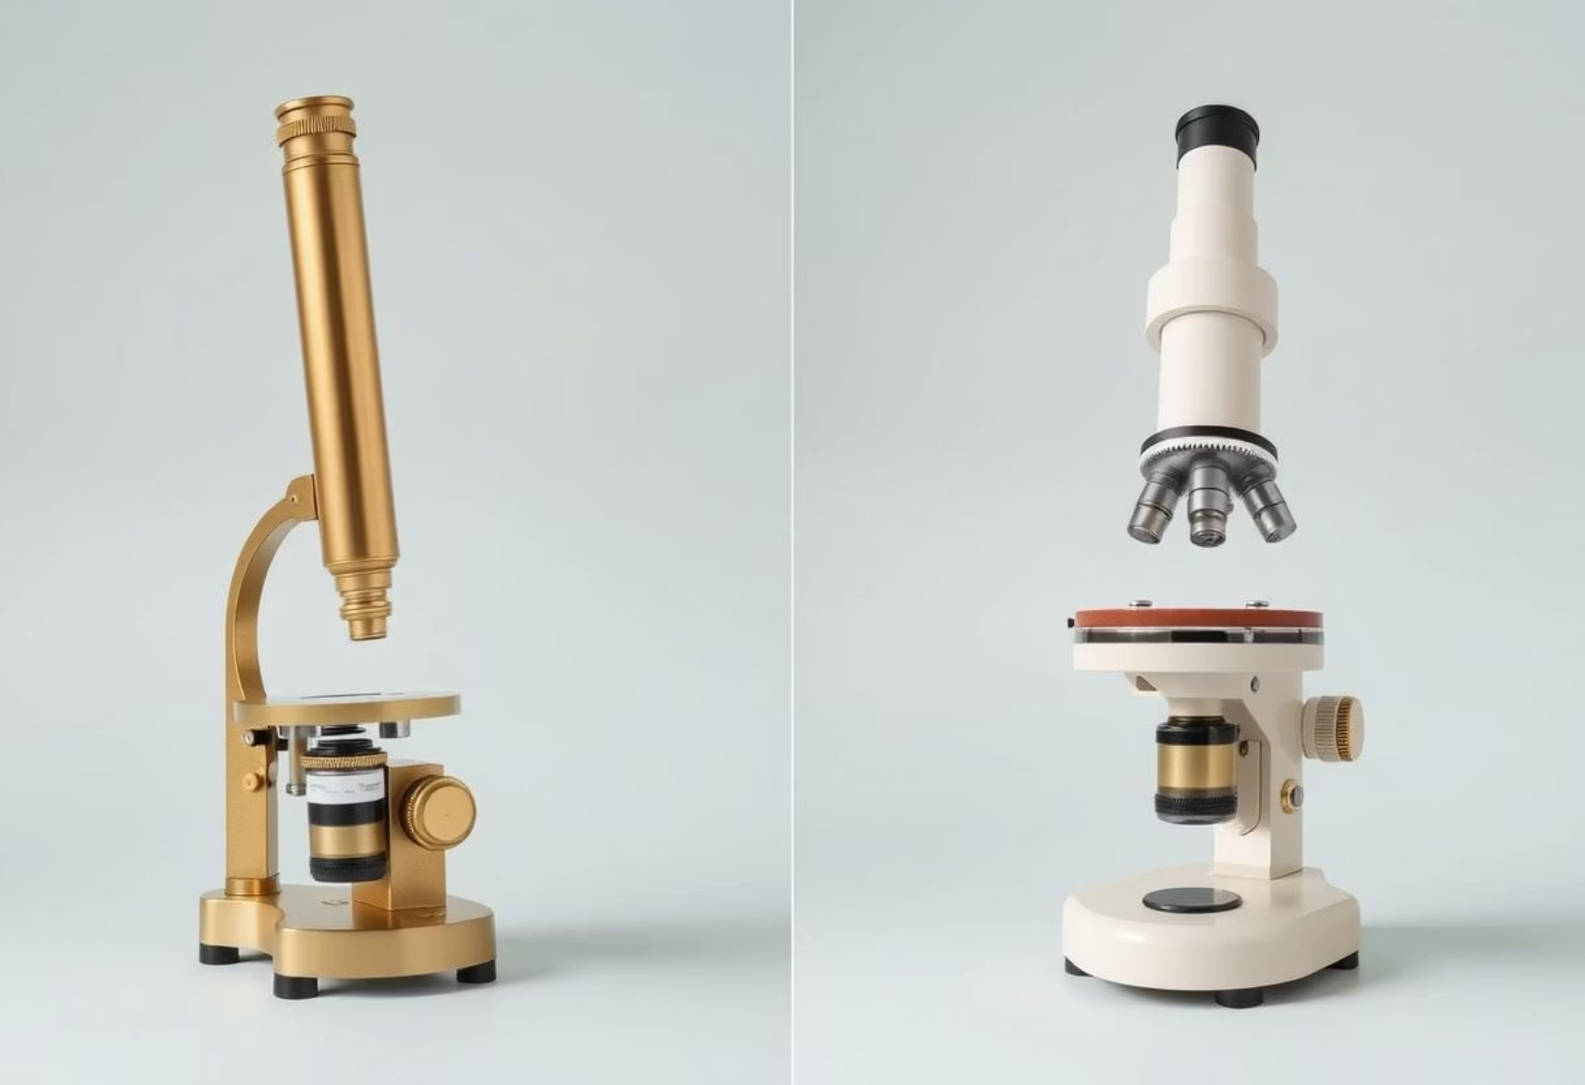



Why BioScope Explorer?
Problem Statement
Limited access to physical microscopes
High costs, maintenance of lab equipment
Lack of interactive, risk-free tools
Solution & Audience
Solution
Target Audience
Web-based, interactive microscope simulation
High school and college biology students
Hands-on experience, no physical constraints
Educators for classroom demonstrations
Science enthusiasts and hobbyists

Slide 3
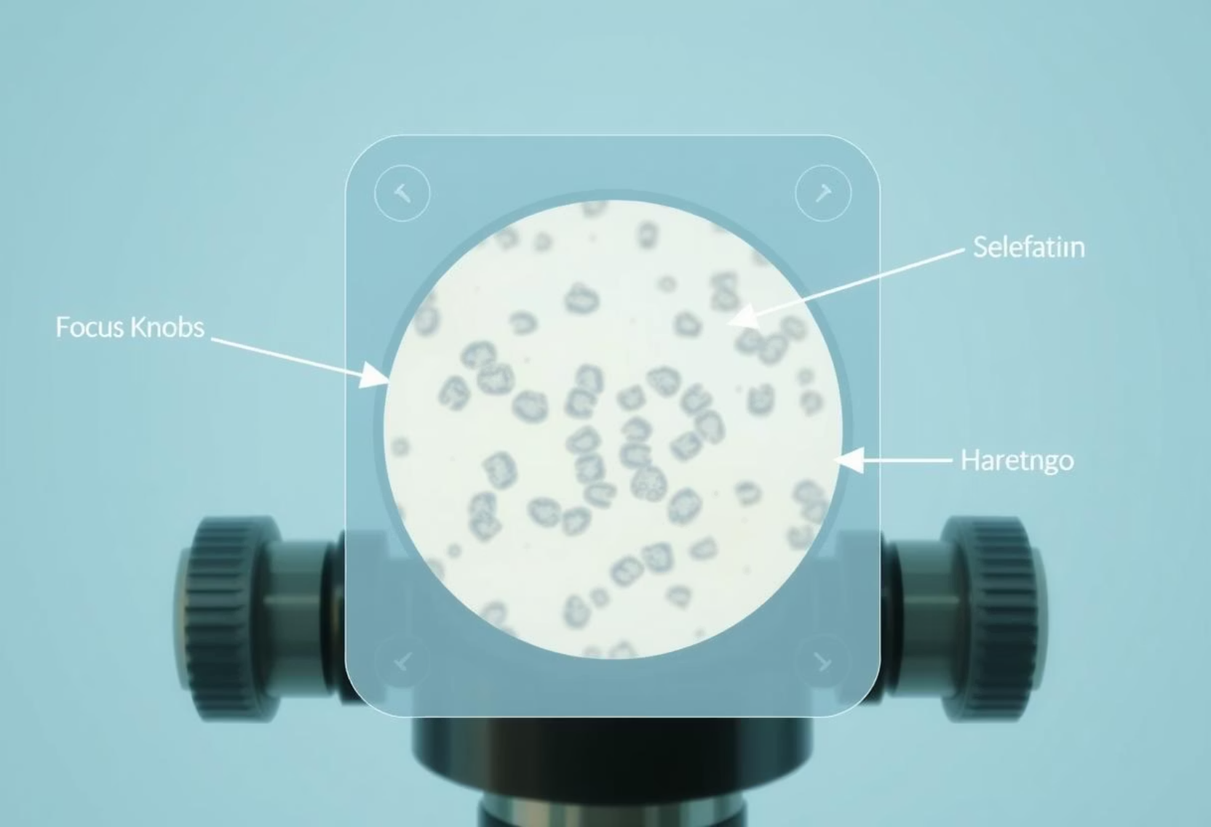

Project Overview: What is BioScope Explorer?
A virtual lab tool replicating a compound microscope with key features.
Adjustable Magnification
Switch between 40x, 100x, 400x views
Interactive Controls
Focus, slide movement, light intensity
Specimen Gallery
Pre-loaded samples: plant cells, blood cells, bacteria
Unique Selling Points
Educational Modules
No setup or cleanup required
Built-in tutorials on parts and usage
Accessible on any device with a browser

Slide 4

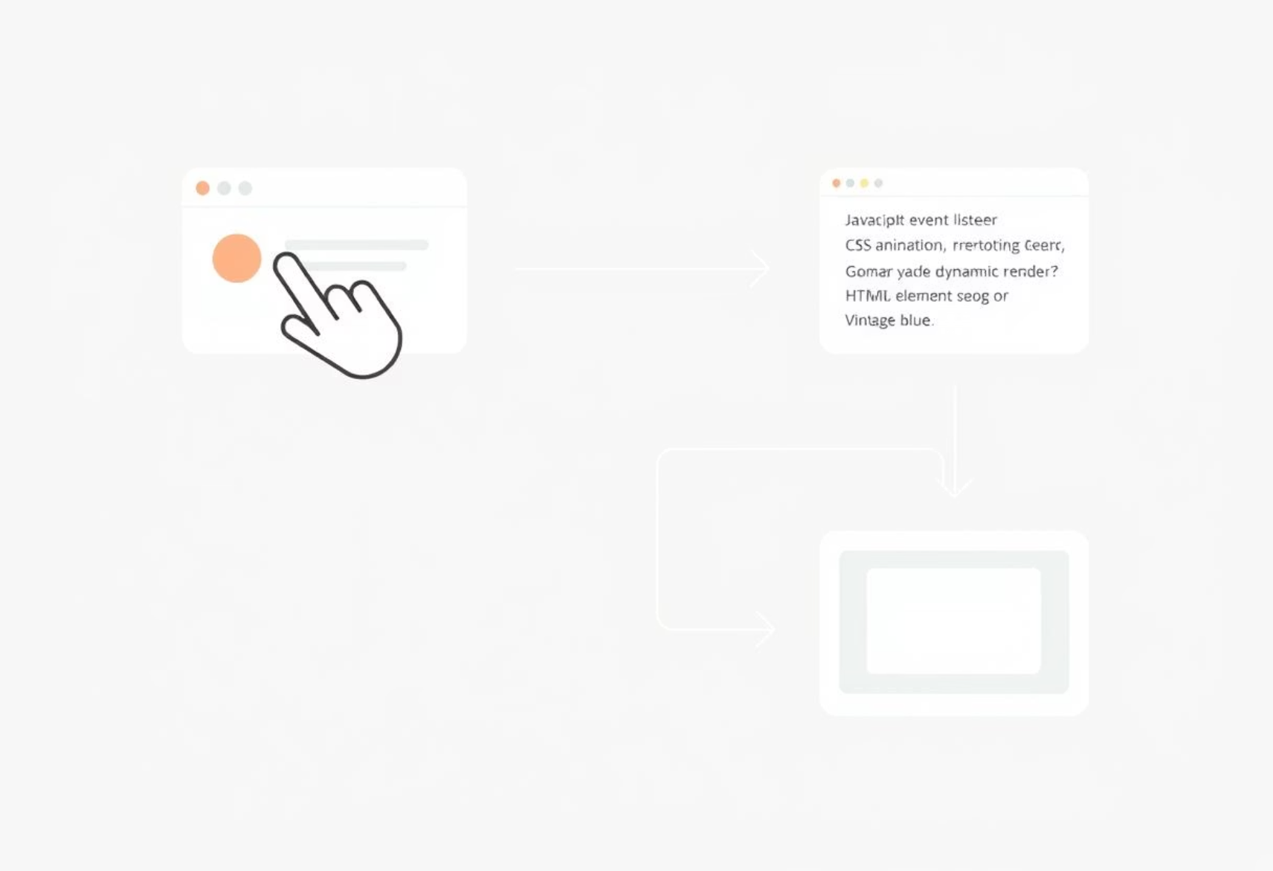




How It Works: User & Technical Flow
User Interaction Flow
Technical Workflow
Launch Simulation
Open web app; default 40x view
Adjust Settings
Toggle magnification, drag slide, adjust focus
Explore Specimens
Select from gallery; observe details
Learn
Access built-in tutorials
JavaScript event listeners detect interactions
CSS animations mimic lens focus and slide movement
Dynamic rendering updates specimen details

Slide 5







Technologies Used
BioScope Explorer leverages modern web technologies for a seamless and responsive user experience.
Frontend Development
Libraries & Tools
HTML5/CSS3 for responsive layout
Font Awesome for interactive icons
JavaScript for UI updates and event handling
Google Fonts for modern typography
GitHub Pages for free deployment

Slide 6
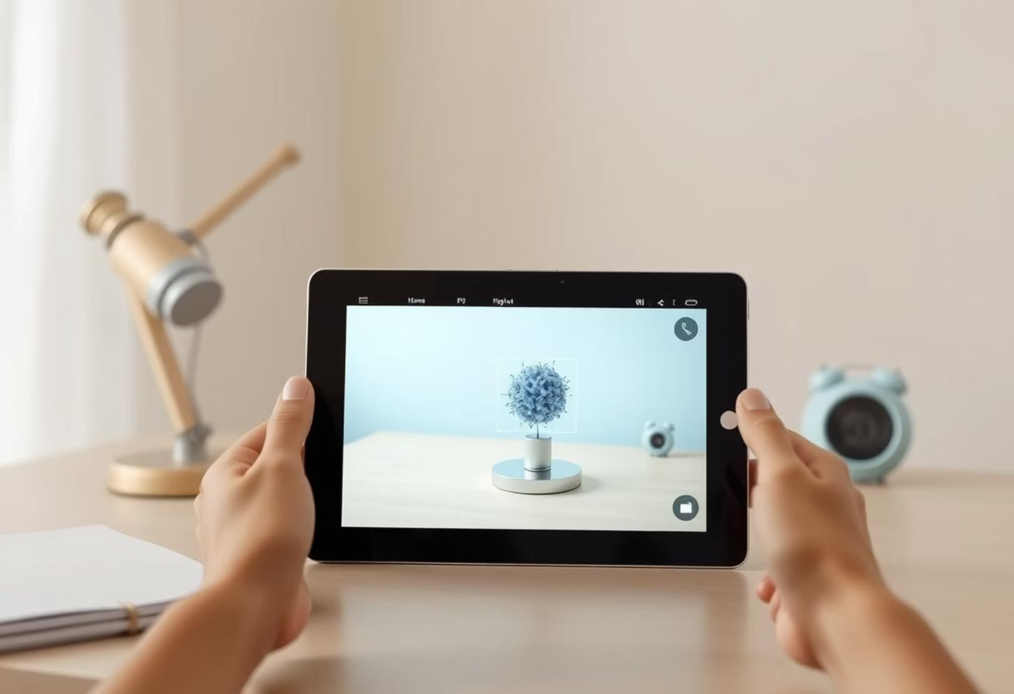




Future Enhancements
Short-Term Goals (1 Year)
3D Specimens
Integrate Three.js for rotatable 3D cell models
AR Mode
WebXR overlay on real-world surfaces
Long-Term Vision
Gamification
Collaborative Lab
Expand to Other Tools
Quizzes, scoring, badges
Multi-user virtual classrooms
Telescopes, spectrophotometers

Slide 7
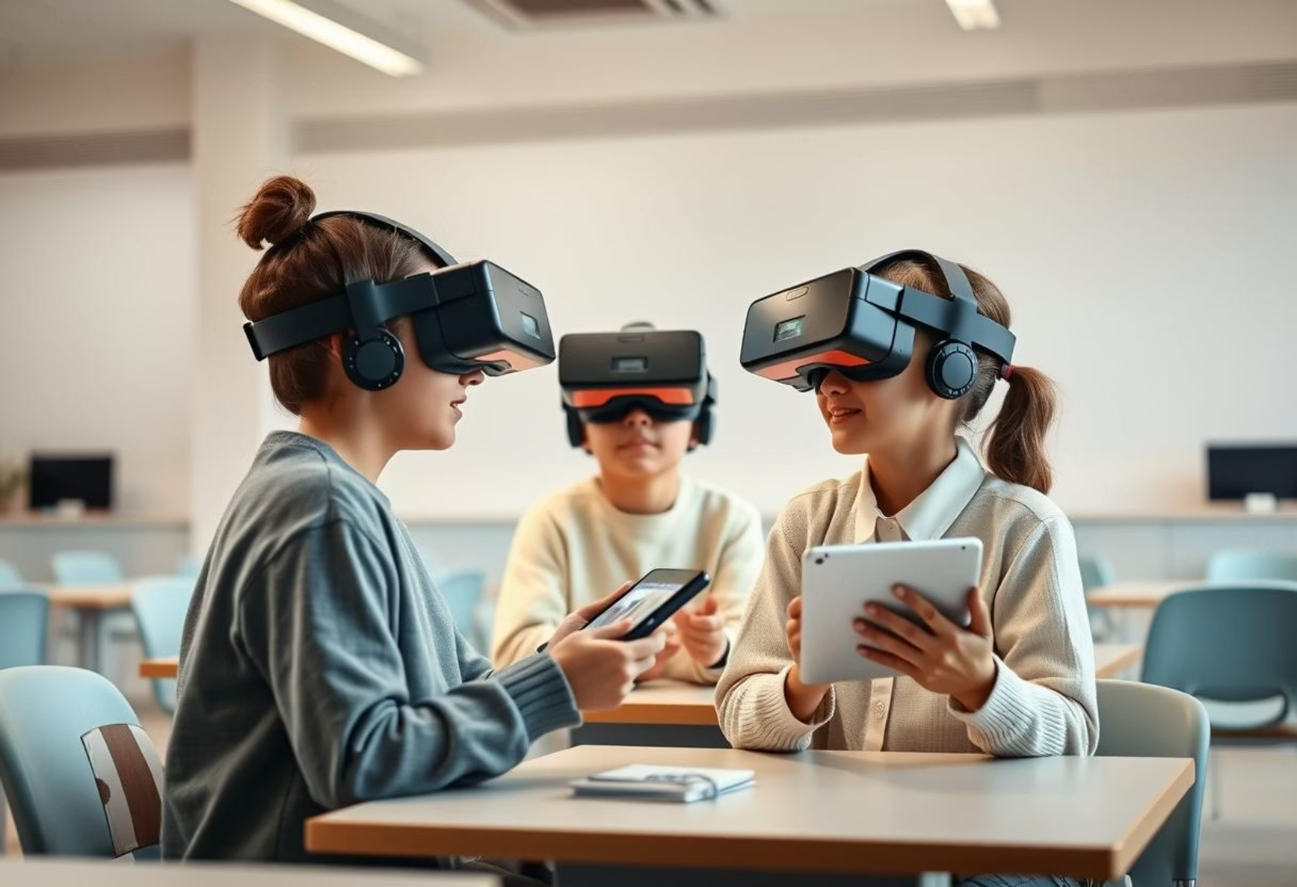



Conclusion: Impact of BioScope Explorer
Educational Impact
Makes microscopy accessible
Reaches underserved schools
Practical Benefits
Reduces costs of physical labs
Eliminates risks in experiments
BioScope Explorer revolutionizes science education, offering an innovative and equitable learning solution.

